Slide 1






KONGU ENGINEERING COLLEGE
PERUNDURAI ERODE-638060
ELECTRONICS AND COMMUNICATION
ENGINEERING
KEC IDEATHON
HEATER BOTTLE
Team Lead: Dhanush Kumar M P (21ECR051)
Team Members: Bhoovitha S ( 21ECR031)
Amirthavarshini S A( 21ECR013)
Technology Readiness Level: TRL – 2
Team Mentor with Designation and Department:
Mr. G. Vibin Mammen Vinod (Assistant Professor) - ECE
In association with:

Slide 2


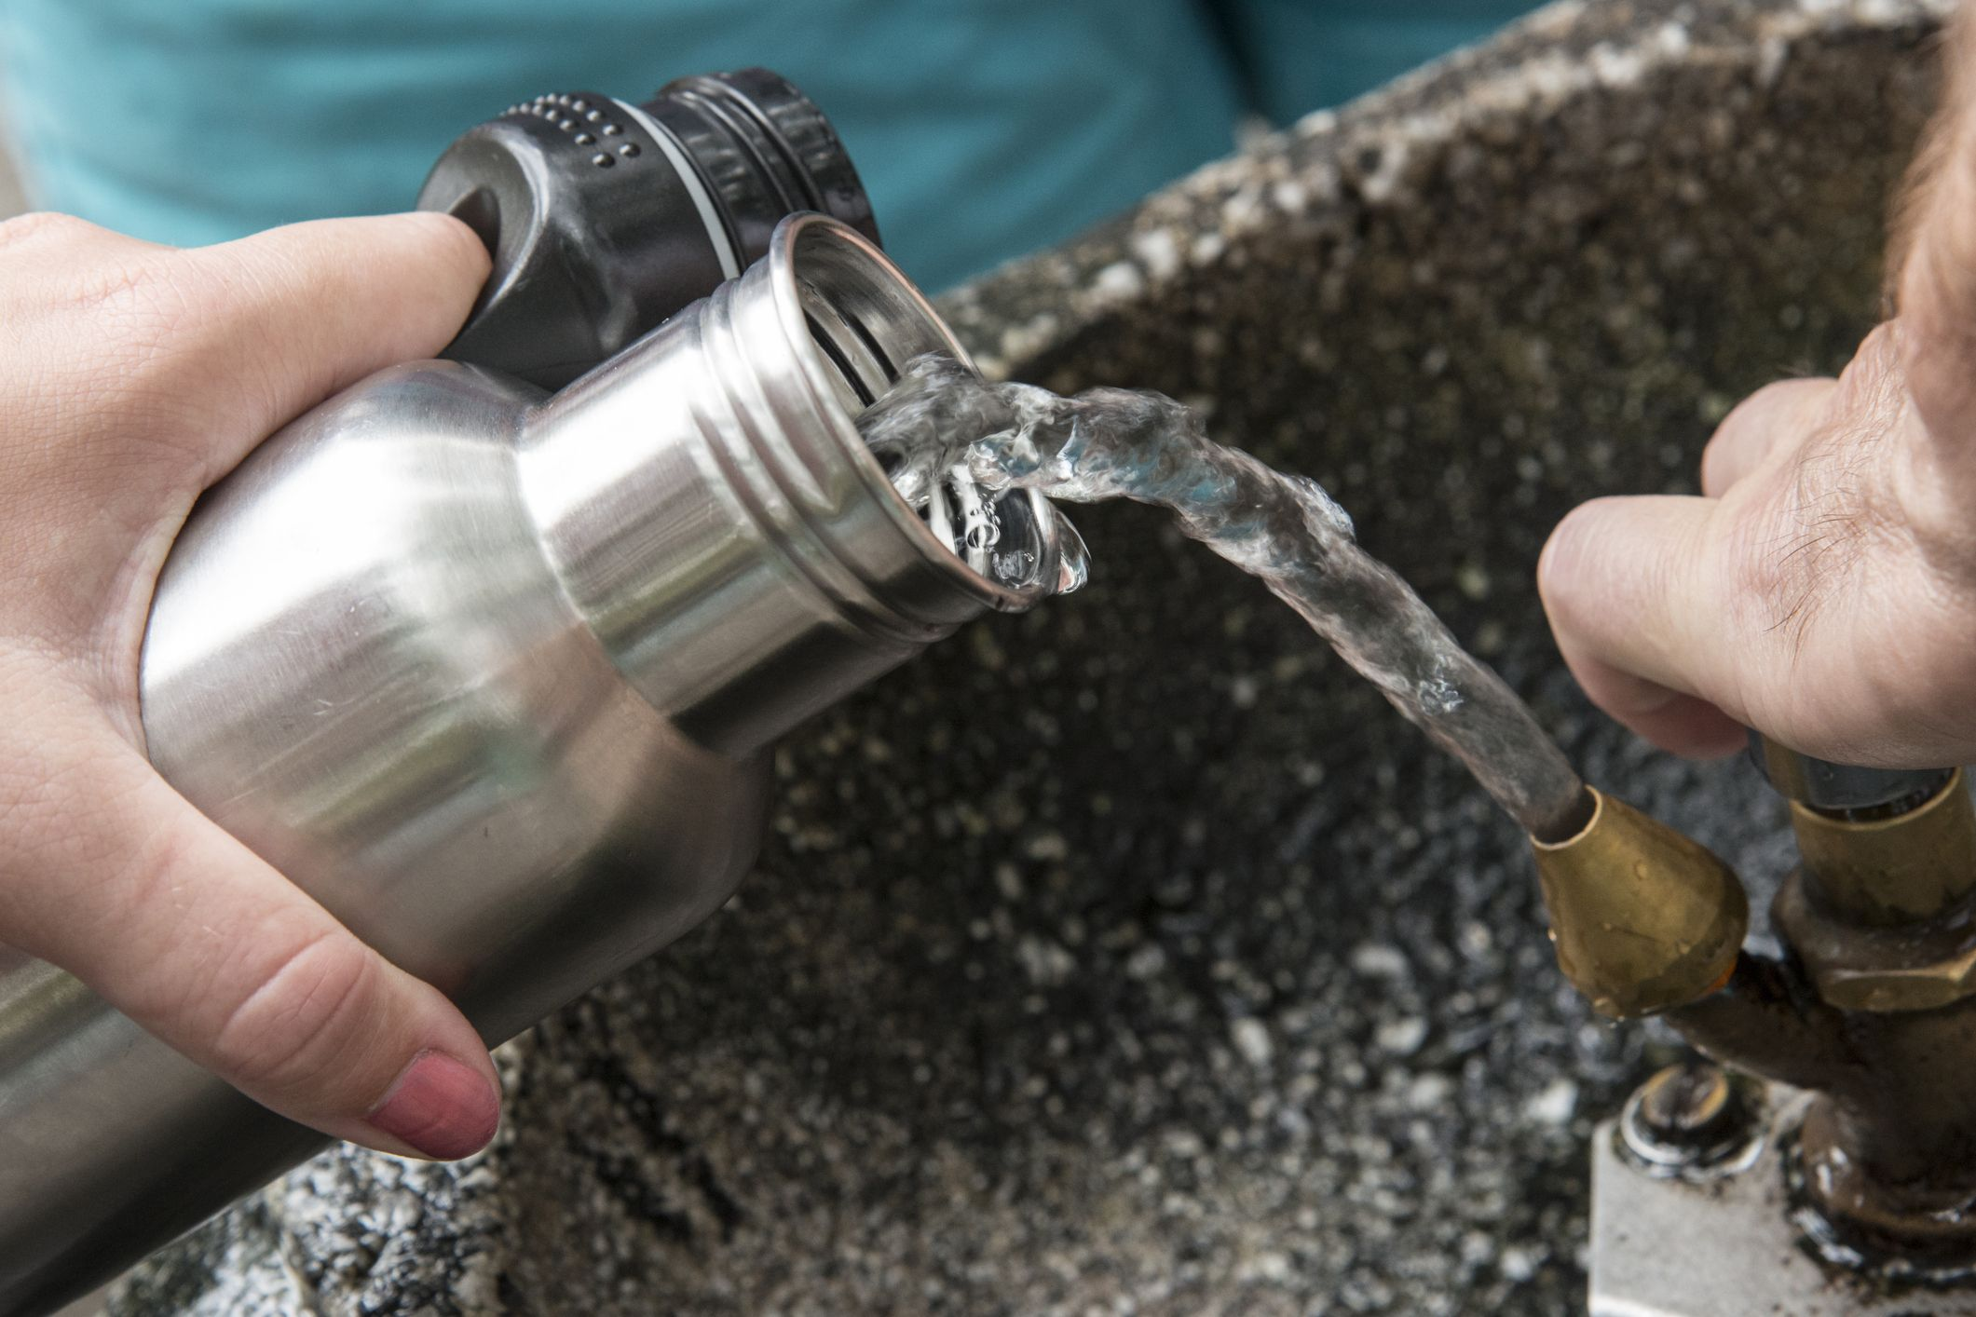
The Problem
People cannot find hot water while travelling long distance
Even they use flask it only stores the hot water till it gets emptied
Many patients are suffering without getting hot water after their flask gets emptied
Mostly our product will help tourists, socialist, patients etc. ….

Slide 3
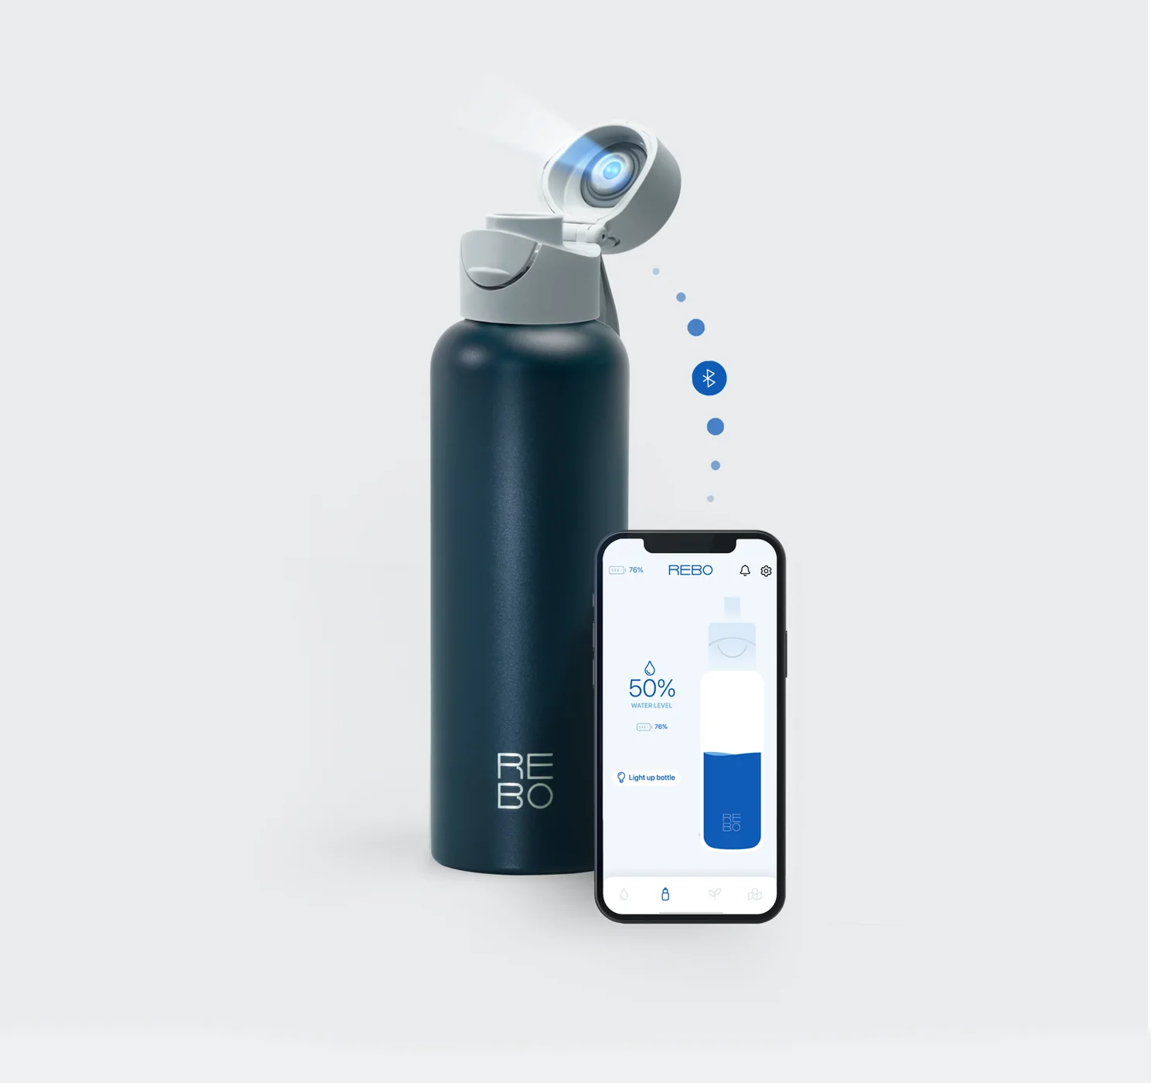
The Solution
Due to these pain points we came up with a solution called
“HEATER BOTTLE”
Using this bottle we can heat the cold water whenever and wherever we want
We can carry it easily to all the places as like of normal water bottles as it is light in weight.

Slide 4
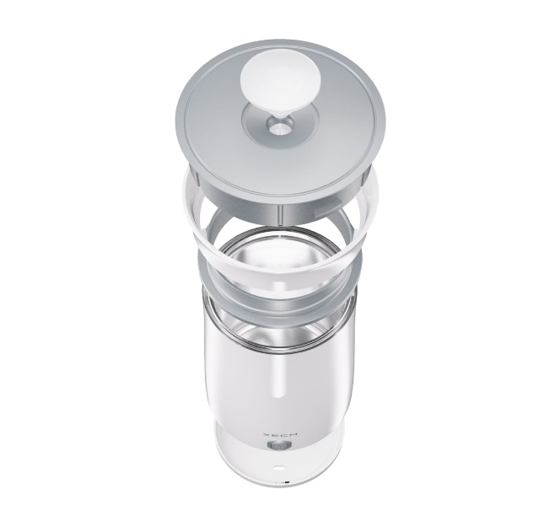
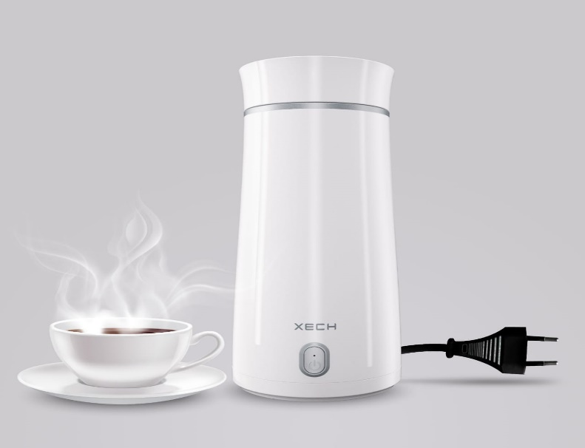
How flask to heater bottle ?
Initially we are going to modify the normal flask into a heater bottle
Here we are going to fix a rod like material in the bottle cap and that transfers the heat to the water
At first we will check it by making wire connection and test it
If this suits good then we will proceed to have a wireless heater bottle
We also fix a temperature sensor in the bottle to notify if the water is heated .

Slide 5
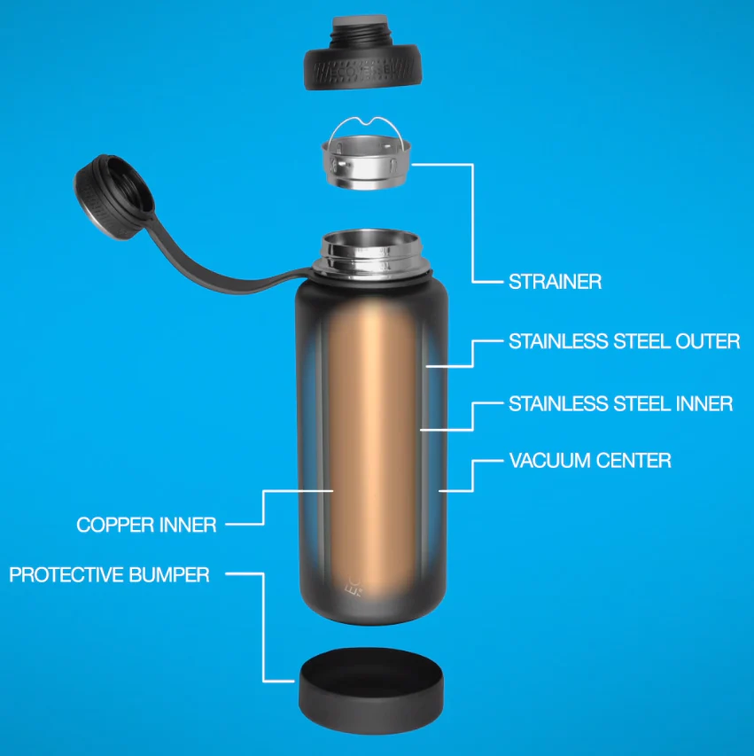
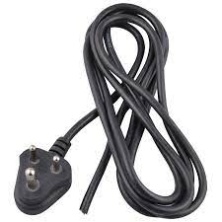
Flowchart / Product workflow
TOP CAP
Stainless steel outer
Thermoset plastic
Stainless steel inner
Vaccum center where the battery is placed
Copper inner
Protective bumper
HEATER BOTTLE
Heating element
Plug

Slide 6
Competitors
OTHER PRODUCTS | OUR PRODUCT
Should have special maintanence and high cost | Little care is enough and affordable cost
Stores the hot water and heat upto a certain temperature | Heat the cold water and also purifies it
Need stuffs to clean the heater | It can easily removed and cleaned
Little bit slower in heating And over a period efficiency gets reduced | Fast heating and we can set the temperature range . It also notifies when it completes heating
Other products:- example – XECH with capacity 350 millilitres made up with material Plastic
Supplying voltage/wattage 220 V(AC)/300W

Slide 7
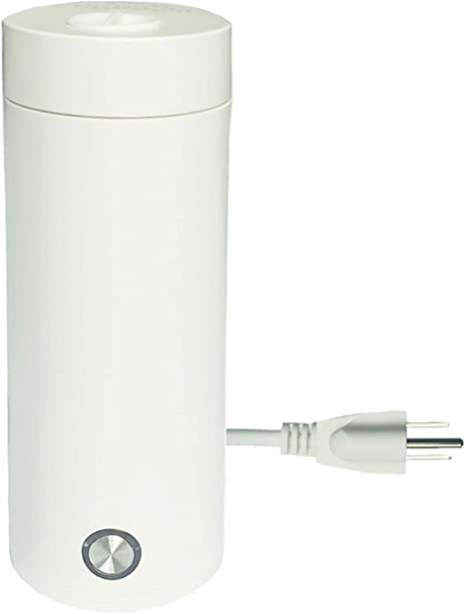
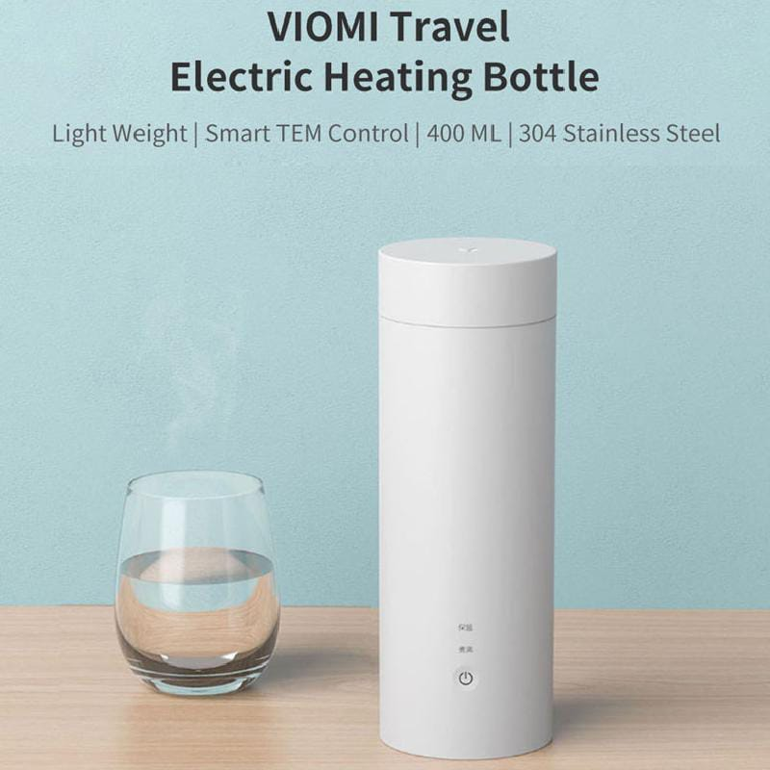
Idea - Current Status / Future Plan
First we are going to check for 1L of water with 12V. And as of now we are planning to supply electricity by wire connection to heat the water
If this workout and In future the electricity supply will be replaced by rechargeable batteries

Slide 8
Value proportion
PRODUCT
CUSTOMER
EXPERIENCE
Less weight and easy to carry
Purifies the water and maintain your health
Whenever need hot water you can get
BENEFITS
Affordable cost
Efficiency
Less weight
Quality
WANTS
Performs dual action 1)heating
2)purifies
FEARS
Some may think cost is high
Little care should be taken
Provides instant hot water and also it undergoes purification
NEEDS
Affordable cost with better features

Slide 9
Thank You !!

